Slide 1

Software Engineering
Software Project Management, Architecture & Design
Software Project Management
Department of Computer Science and Engineering
Acknowledgement: Dr. Phalachandra HL, Prof. Anand MS, authors of the prescribed textbooks and materials sourced online.

Slide 2

Software Project Estimation and Scheduling
List of Contents
Software Project Estimation
Types of Estimation Techniques
Best Practices for Estimation
CoCoMo model
Types
Calculation of Efforts and Time
Software Project Scheduling
Common Causes of Delays
Principles
Department of Computer Science and Engineering

Slide 3
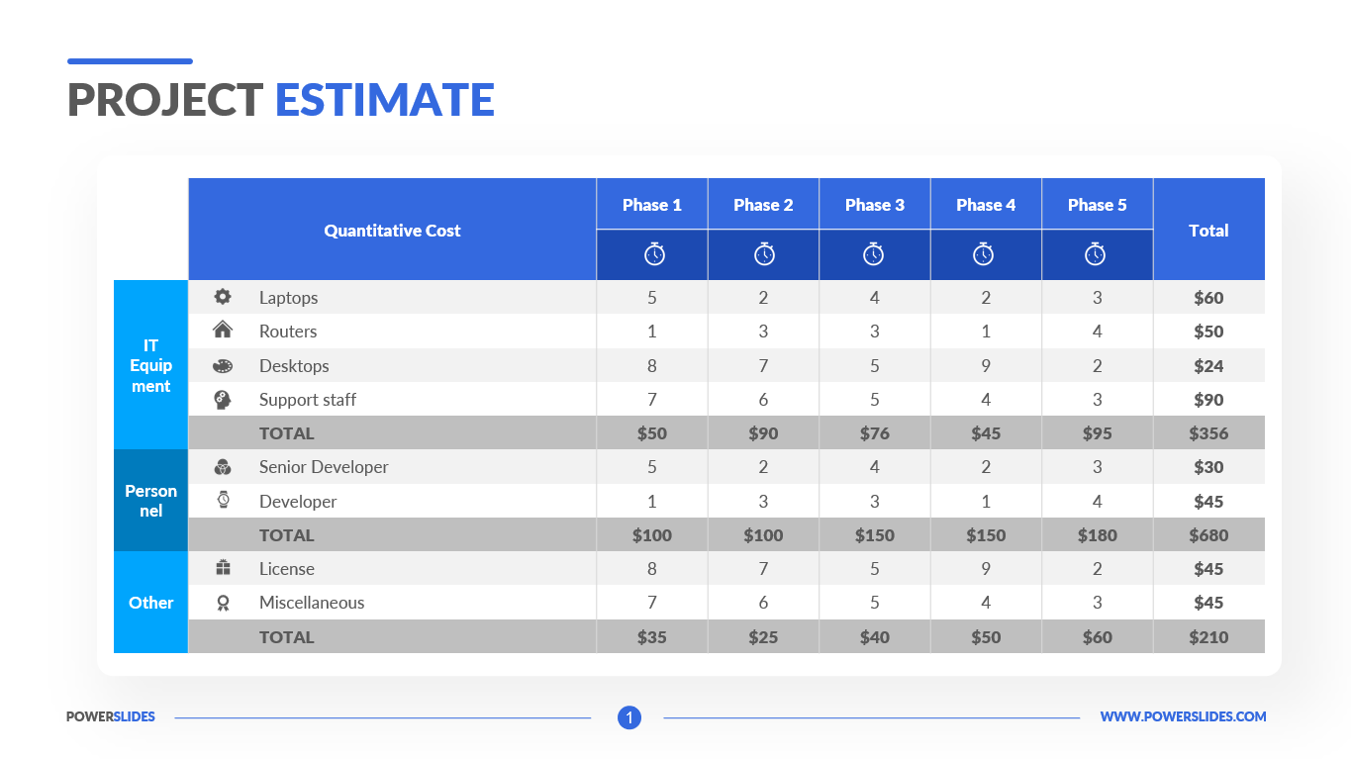
Software Estimation
Software estimation techniques help forecast key project variables like cost, time, scope, risk, resources, and quality. These tools improve accuracy in predicting project outcomes.

Slide 4
Types of Estimation Techniques
1. Experience-Based Technique
Relies on the manager's experience from past projects.
Group estimation approach can improve accuracy by considering multiple perspectives.
Involves judgment-based estimates of effort requirements.
Challenge: New projects may differ significantly from past projects, limiting the effectiveness of experience-based estimates.

Slide 5
Types of Estimation Techniques
2. Algorithmic-Based Technique
This technique helps predict the required effort, resources, and time based on various project attributes such as size, complexity, and team experience.
Effort = A × Size^{B} × M
A: Constant factor based on organizational practices.
Size: Estimated code size or functionality (e.g., function points).
B: Complexity factor, usually between 1 and 1.5.
M: Factors affecting process, product, and team.

Slide 6
Best Practices for Estimation
Develop a range of estimates (worst, expected, best) rather than a single estimate.
Use calibrated models when possible, based on local data.
Understanding the type of software and predefined choices (e.g, language, hardware) improves estimation accuracy.

Slide 7
CoCoMo Model
The Constructive Cost Model (COCOMO) is a software cost estimation model used to predict the effort, cost, and timeline needed for a software development project.
Key Parameters:
1] Efforts: Amount of labor that will be required to complete a task. It is measured in person-months units.
2] Schedule: The amount of time required for the completion of the job. It is measured in the units of time such as weeks, and months.

Slide 8
COCOMO Project Types
1.Organic
2. Semi-detached
3. Embedded
Small team size.
Well-understood, previously solved problems.
Team members have moderate experience.
Example: Simple business applications.
Medium team size
.
Moderately complex problems with mixed familiarity.
Requires more experience, guidance, and creativity.
Example: Compilers, certain embedded systems.
Large team size.
Highly complex,
innovative problems.
Demands extensive experience and creativity.
Example: Real-time systems, advanced embedded systems.

Slide 9
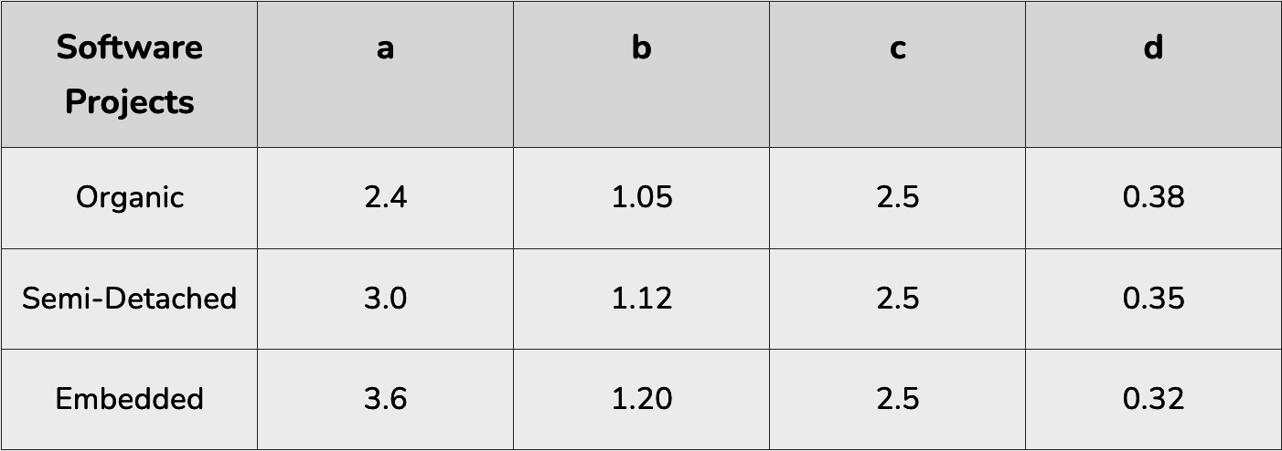
Calculation of Efforts and Time
E = a*(KLOC)^{b}
Tdev = c*(E)^{d}
Person required = Effort/ Time
E (Effort): Represents the effort applied in person-months (PM).
KLOC (Kilo Lines of Code):Estimated size of the software product measured in thousands of lines of code.
Tdev (Development Time):The development time required, expressed in months.
a, b, c,d (Constants): determined by the category of the software project (Organic, Semi-detached, or Embedded).

Slide 10
Example
Suppose that a Basic project was estimated to be 400 KLOC (kilo lines of code). Calculate effort and time for Embedded mode of development.
Answer:
Effort = 3.6 × (400)^{1.20} ≈ 4772 person-month.
Tdev = 2.5 × (4772)^{0.32} ≈ 38 months.
Person required = 4772/38 ≈ 125

Slide 11
Software Project Scheduling

Slide 12
Software Project Scheduling
A project schedule is a tool used to outline tasks, allocate organizational resources, and define the timeframe for completing each task.
Advantages of Project Scheduling:
It ensures that everyone remains on same page as far as tasks get completed, dependencies, and deadlines.
It helps in identifying issues early and concerns such as lack or unavailability of resources.
It also helps to identify relationships and to monitor process.
It provides effective budget management and risk mitigation.

Slide 13
Common Causes of Delays
Unrealistic Deadlines: Set by external parties and forced on the team.
Changing Requirements: Not reflected in the schedule.
Underestimation: Effort or resources underestimated.
Risks: Predictable or unpredictable risks not considered.
Technical & Human Difficulties: Issues that could not have been foreseen.
Miscommunication: Leads to delays.
Lack of Management Action: Failure to address delays promptly.

Slide 14
Principles of Software Scheduling
Compartmentalization: Break down the project into manageable activities and tasks.
Interdependency:Determine which tasks depend on others and which can occur in parallel.
Time Allocation:Allocate work units (e.g., person-days) to each task with start and end dates.
Effort Validation:Ensure that the allocated number of people is not exceeded at any given time.
Defined Responsibilities:Assign each task to a specific team member.
Defined Outcomes:Each task should result in a specific work product or part of a deliverable.
Defined Milestones:Associate tasks with milestones that mark significant project progress.

Slide 15
THANK YOU
Software Project Management
Department of Computer Science and Engineering
‹#›

